Slide 1
Team Ferrero
Members: Ananya Paul, Leanna Mulvihill, Romane d’Oncieu & Saniya Shah
PC033: How might we use AR/VR to engage confectionary product consumers to educate them about the quality and sourcing of ingredients in Ferrero products?

Slide 2
Tech Cooking Classes
Notes:
key benefits of the product , why it is feasible, and optionally, the future plans(vision)).

Slide 3








VR Harvesting Experience

Slide 4
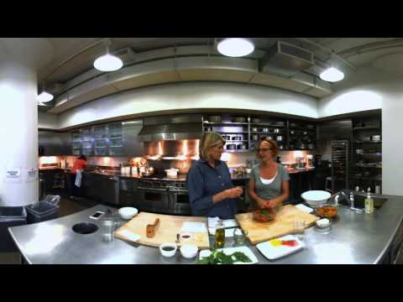

360° projection room

Slide 5


Interactive Display

Slide 6

Experiments
Video can make an impact
People prefer interactive images (VR,360)
Notes:
Leanna - 45 secs

Slide 7
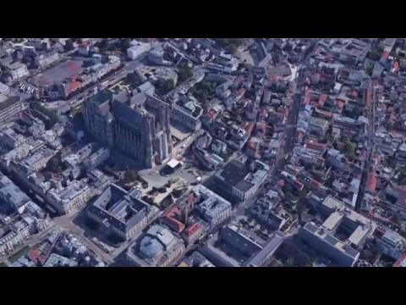

Slide 8
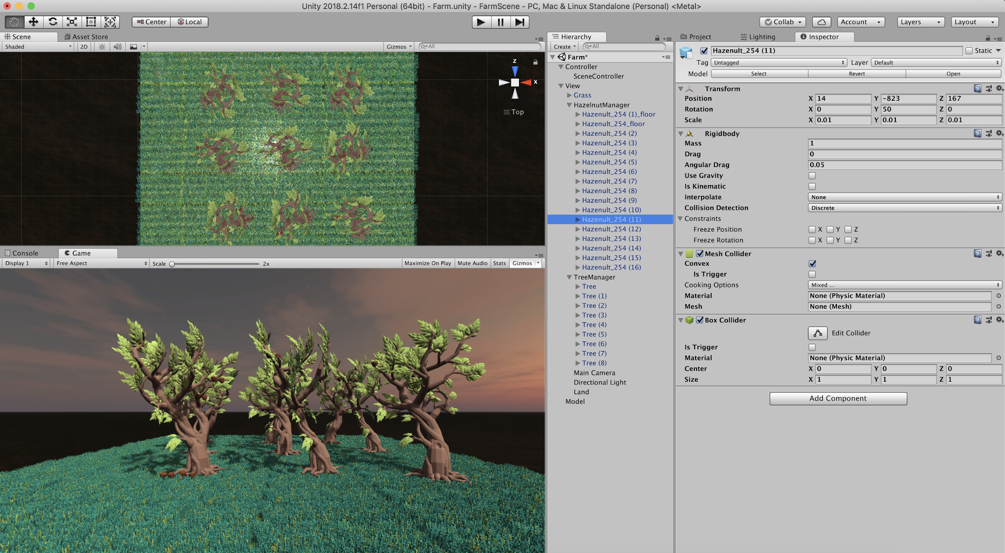

Slide 9
